Slide 1
CVS ViewVC
Web-base version control repository browsing.

Slide 2
Overview
What is CVS?
DirecTV ViewVC System.
CVS for Developer.

Slide 3
III. What is CVS?
About CVS ViewVC.
ViewVC Features.
What are “HEAD” and “MAIN”?

Slide 4


I. What is CVS?
About CVS ViewVC.
What is CVS?
  "CVS" is an acronym for the "Concurrent Versions System".
  CVS is a "Source Control" or "Revision Control" tool designed to keep track of collections of files in a shared directory called "The Repository".
  CVS is intended to handle source control for files in three major situations:
    Multiple developers working on the same files.
    Tracking a stream of releases from a source vendor.
    Branching development.
Confidential

Slide 5
I. What is CVS? (cont.)
About CVS ViewVC. (cont.)
What is ViewVC?
  ViewVC is a browser interface for CVS and Subversion version control repositories.
  It generates templatized HTML to present navigable directory, revision, and change log listings.
  It can display specific versions of files as well as diffs between those versions.
Confidential

Slide 6
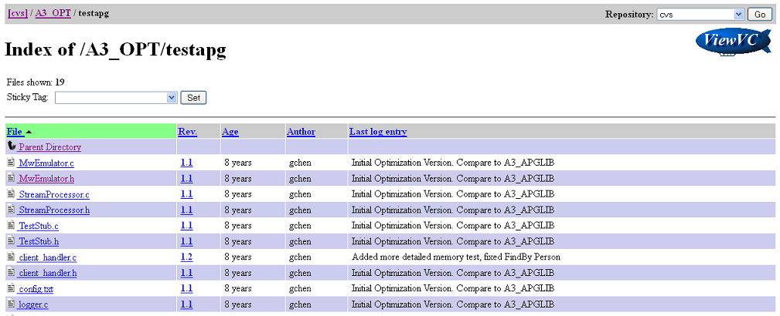
I. What is CVS? (cont.)
ViewVC Features.
Directory View : Shows a list of files and subdirectories in a directory of the repository, along with metadata like author names and log entries.
Confidential

Slide 7
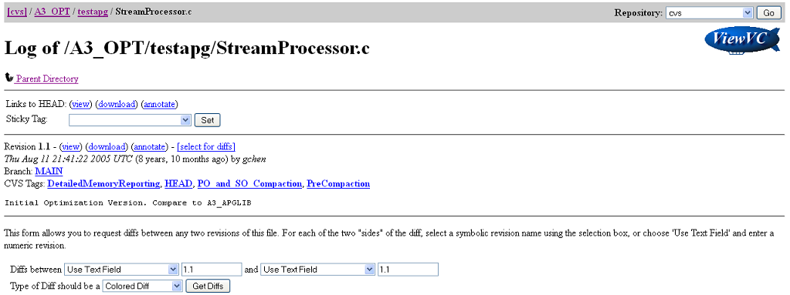
I. What is CVS? (cont.)
ViewVC Features. (cont.)
Log View : Shows a revision by revision list of all the changes that have made to a file or directory in the repository, with metadata and links to views of each revision.
Confidential

Slide 8
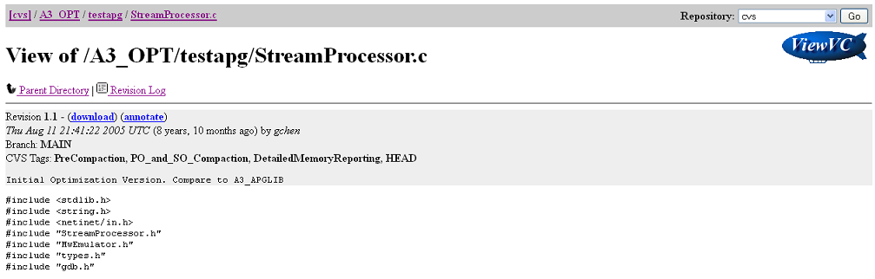
I. What is CVS? (cont.)
ViewVC Features. (cont.)
File Contents View (Markup View) : Shows the contents of a file at a particular revision, with revision information at the top of the page. File revisions which are GIF, PNG, or JPEG images are displayed inline on the page. Other file types are displayed as marked up text.
Confidential

Slide 9
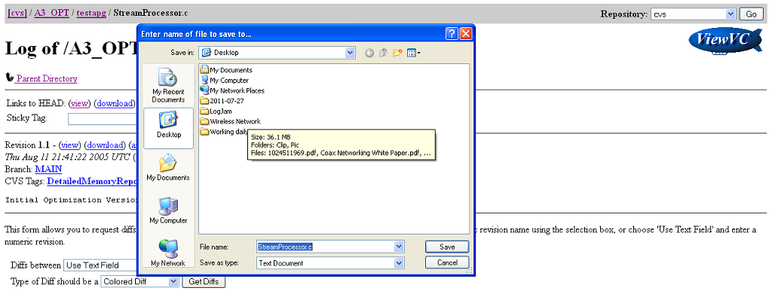
I. What is CVS? (cont.)
ViewVC Features. (cont.)
File Download (Checkout View) : Retrieves the unaltered contents of a file revision. Browsers may try to display the file, or just save it to disk.
Confidential

Slide 10
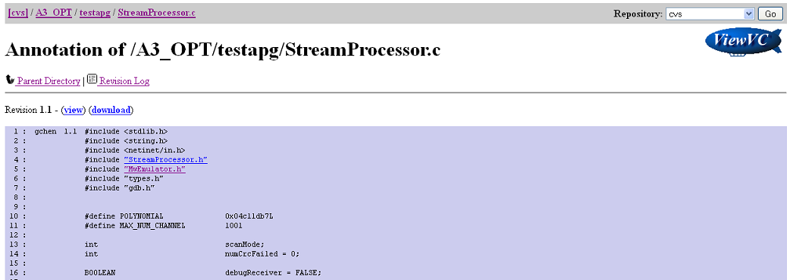
I. What is CVS? (cont.)
ViewVC Features. (cont.)
File Annotate View : Shows the contents of a file revision and breaks it down line by line, showing the revision number where each one was last modified, along with links and other information. This view is disabled in some ViewVC configurations.
Confidential

Slide 11
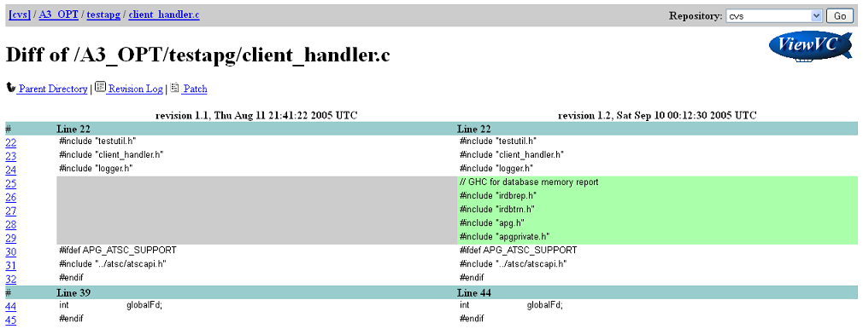
I. What is CVS? (cont.)
ViewVC Features. (cont.)
File Diff View : Shows the changes made between two revisions of a file.
Confidential

Slide 12
I. What is CVS? (cont.)
ViewVC Features. (cont.)
Directory Tarball View : Retrieves a gzipped tar archive containing the contents of a directory. This view is disabled in the default ViewVC configuration.
Directory Query View : Shows information about changes made to all subdirectories and files under a parent directory, sorted and filtered by criteria you specify. This view is disabled in the default ViewVC configuration.
Confidential

Slide 13
I. What is CVS? (cont.)
ViewVC Features. (cont.)
Revision View : Shows information about a revision including log message, author, and a list of changed paths. For Subversion repositories only.
Graph View : Shows a graphical representation of a file's revisions and branches complete with tag and author names and links to markup and diff pages. For CVS repositories only, and disabled in the default configuration.
Confidential

Slide 14
I. What is CVS? (cont.)
What are “HEAD” and “MAIN”?
HEAD and MAIN are built-in tags that don't show up in the "log" or "status" listings. They are interpreted directly by CVS.
"HEAD" refers to the latest revision on the current branch in the Repository. The current branch is either the main line of development, or a branch in development created by placing a branch tag on a set of files and checking out that branch.
“MAIN" refers to the revision on the current branch you last checked out, updated, or committed. If you have not modified your working file, “MAIN" is the committed revision matching it.
Confidential

Slide 15
I. What is CVS? (cont.)
What are “HEAD” and “MAIN”? (cont.)
Most of the time MAIN and HEAD refer to the same revision. They can become different in two ways:
  Someone else changed HEAD by committing a new revision of your file to the Repository. You can pull MAIN up to equal HEAD by executing "update".
  You moved MAIN backward by executing "checkout" or "update“ to a special revision/tag or date. CVS records a sticky tag and moves your files to the specified earlier revision. You can clear the sticky tag and pull MAIN up to equal HEAD again by executing "update -A".
Confidential

Slide 16
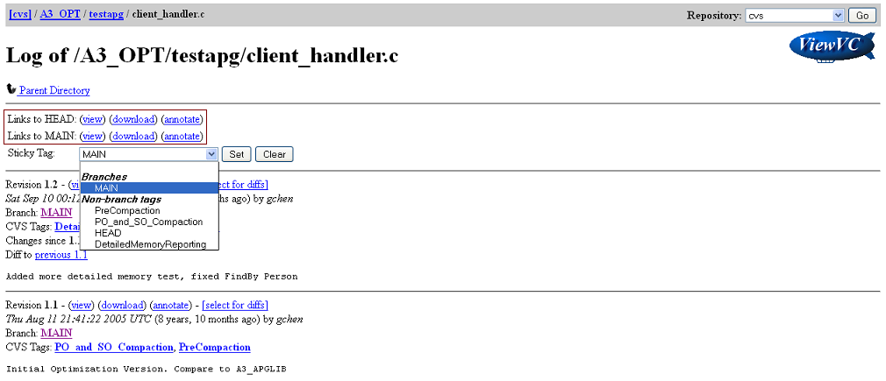
I. What is CVS? (cont.)
What are “HEAD” and “MAIN”? (cont.)
Confidential

Slide 17
II. DirecTV ViewVC System
Request New Account.
Account Permission.
Directory Structure.

Slide 18
II. DirecTV ViewVC System.
Request New Account.
To request a CVS account, you are required to provide the encrypted password string. Follow the procedures below to create the encrypted password string:
    Download the file encrypt.zip from http://172.31.59.94/wiki/download/attachments/20415391/encrypt.zip?version=1&modificationDate=1302046728610&api=v2
    Uncompress it to a folder ( i.e C:\encrypt)
    Open a MS-DOS session.
    cd to the directory which has encrypt.exe (i.e cd c:\encrypt).
    Execute the encrypt utility to generate the encrypt password string (i.e C\encrypt\encrypt <your password>) and note the encrypted string.
Confidential

Slide 19
II. DirecTV ViewVC System. (cont.)
Request New Account. (cont.)
Submit a JIRA task request to CM with below info:
    Name.
    Email.
    Role (tester / developer)
    The manager who the user will work for.
    The special access to secure sources: dms, fdm, dtcp, cdidrivers, moca_manager, xmp2
    The encrypted password (generated in above).
Only Name, Email, The encrypted password string are requested for CVS password reset.
Confidential

Slide 20
II. DirecTV ViewVC System. (cont.)
Account Permission
In DirecTV ViewVC system, we have 2 account types:
  Tester
  Developer
You are requested to login before using the system at http://172.31.59.87/viewvc/
Which folders that your account have not permission to access, revision column displays text: “error: path is not accessible”.
Confidential

Slide 21
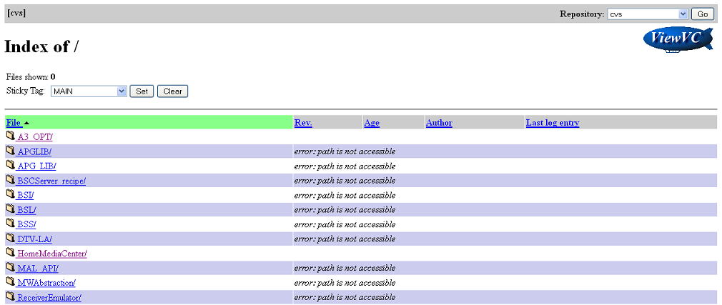
II. DirecTV ViewVC System. (cont.)
Directory Structure.
Confidential

Slide 22
III. CVS for Developers
DirecTV CVS
Copy-Modify-Merge Model.
Basic CVS commands.
How to upload a file?

Slide 23
III. CVS for Developer.
DirecTV CVS
Only CM team do broadcasting the build (and build’ related things, such as: kernel, plugins, build note, etc..) to CVS.
As developer role, you just have permission to work on folders which was requested to your CVS account.
What things a developer should know about CVS tool:
  CVS is a system that lets groups of people work simultaneously on groups of files (for instance program sources).
Confidential

Slide 24
III. CVS for Developer. (cont.)
DirecTV CVS
  It works by holding a central “repository” of the most recent version of the files. You may at any time create a personal copy of these files by “checking out” the files from the repository into one of your directories. If at a later date newer versions of the files are put in the repository, you can “update” your copy.
  You may edit your copy of the files freely. If new versions of the files have been put in the repository in the meantime, doing an update merges the changes in the central copy into your copy.
Confidential

Slide 25
III. CVS for Developer. (cont.)
DirecTV CVS (cont.)
  When you are satisfied with the changes you have made in your copy of the files, you can “commit” them into the central repository.
  When you are finally done with your personal copy of the files, you can “release” them and then remove them.
Confidential

Slide 26
III. CVS for Developer. (cont.)
Copy-Modify-Merge Model.
CVS system uses copy-modify-merge model as an alternative to locking. In this model, each user's client contacts the project repository and creates a personal working copy. Users then work simultaneously and independently, modifying their private copies.
Finally, the private copies are merged together into a new, final version. The version control system often assists with the merging, but ultimately, a human being is responsible for making it happen correctly.
Confidential

Slide 27





III. CVS for Developer. (cont.)
Copy-Modify-Merge Model. (cont.)
Confidential

Slide 28
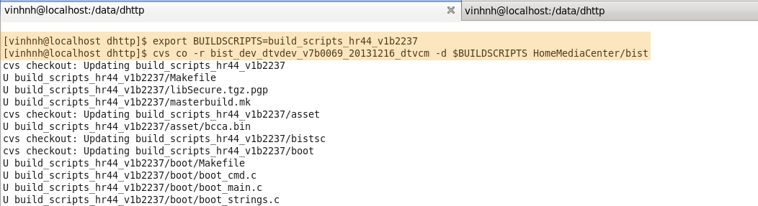
III. CVS for Developer. (cont.)
Basic CVS commands.
cvs <command> –H
  Displays a summary of all the commands available
cvs checkout (or cvs co)
  To make a local copy of a file/folder from the repository.
Confidential

Slide 29
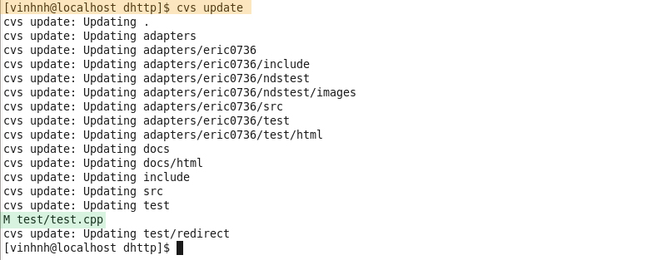
III. CVS for Developer. (cont.)
Basic CVS commands. (cont.)
cvs update
  To update your copy of a file/folder with any changes from the central repository
Confidential

Slide 30
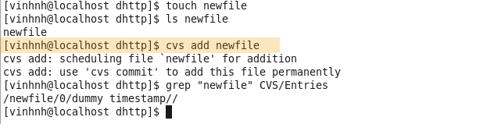
III. CVS for Developer. (cont.)
Basic CVS commands. (cont.)
cvs add and cvs remove
  To make involve a completely new file, or removing an existing one. The commands to use here are:
    cvs add filename.
    cvs remove filename.
Confidential

Slide 31
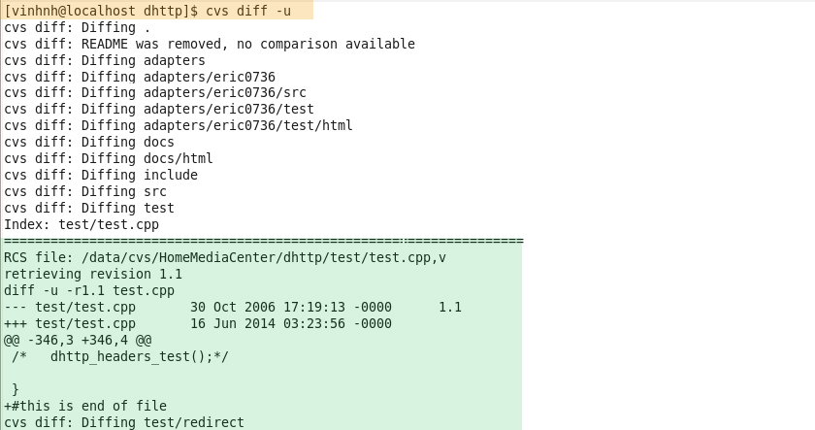
III. CVS for Developer. (cont.)
Basic CVS commands. (cont.)
cvs diff
  To see the differences between your version of the files and the version in the repository.
Confidential

Slide 32
III. CVS for Developer. (cont.)
Basic CVS commands. (cont.)
cvs history
  To find out information about your CVS repositories.
  By default history will show you all the entries that correspond to you. Use –a option to show information about everyone.
cvs commit
  To merge the file back into the repository.
  When doing a commit, if having no updated to the most recent version of the files, CVS notifies this; then you have to first update, resolve any possible clashes, and then redo the commit.
Confidential

Slide 33
III. CVS for Developer. (cont.)
Basic CVS commands. (cont.)
cvs log
  To see the commit messages for files, and who made them.
cvs tag
  Use this command to assign symbolic tags to the nearest repository versions to your working sources.
cvs rtag
  Like tag, rtag marks the current versions of files but it does not work on your local copies but on the files in the repository.
Confidential

Slide 34
III. CVS for Developer. (cont.)
How to upload a file?
Here is the example to upload a file to CVS:
  Go to your working directory:
    cd ~/src/work/
  Check out a file (or a folder) that you need to work on:
    cvs co -d dhttp HomeMediaCenter/dhttp
  Create a file and add it to the repository:
    echo "Add new file into dhttp" > newfile.txt
    cvs add newfile.txt
  Remove a file and update the status to the repository:
    rm RELEASENOTES
    cvs remove RELEASENOTES
Confidential

Slide 35
III. CVS for Developer. (cont.)
How to upload a file? (cont.)
  If you rename a file, you need to do a combination remove and then add.
  To check any change in “makefile” file.
    cvs log makefile
  When done your work from local, you need to execute below command first. It will pull in the changes from the repository that others made. :
    cvs update
Confidential

Slide 36
III. CVS for Developer. (cont.)
How to upload a file? (cont.)
  Commit your files (inside the directory you checked out) to apply your changes to the repository so others can use them:
    cvs commit
  Release your files
    cd .. : go to the upper directory.
    cvs release [-d] module -name : to check-in the files.
      The optional -d will remove the directory and files from your work directory when it is done releasing them.
      The release command will inform you if you made modifications to the files and if there are files it doesn't know about that you may have forgotten to add.
Confidential

Slide 37

Thank you
Confidential

